Slide 1

Recommendation based on Amazon
Food Review
POWERPOINT TEMPLATE
CSE4077- Recommender Systems

Slide 2
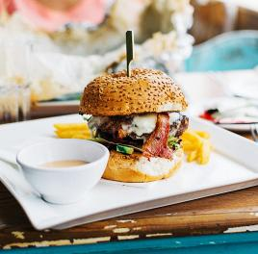
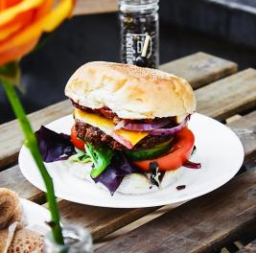
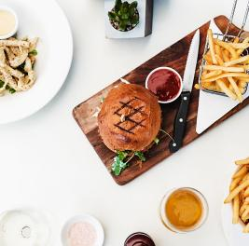
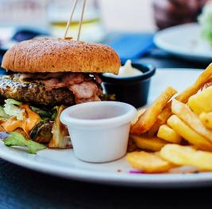
Team Members & Registration numbers:
B. Phanindra Sai- 19MIA1065
O. Naga Sai Kumar- 19MIA1071
M. Jay Kumar Patel- 19MIA1032
T. Siva Nikhi- 19MIA1086

Slide 3


ABSTRACT
Amazon sells lots of products worldwide and it plays a vital role in our life. now we are analyzing more on their food products. Considering that everyone has different purchase profile, a recommendation system is required to help and give a personalized suggestion products based on the user's preferences. In recent years, consumer interest in shopping online is increased globally with a focus on home delivery. We have data filled with reviews and the ingredients of food. We are trying out content based, popularity based, collaborative based filtering and SVM methods and we are finding out the best and their performances. We will be making the model using the reviews of the people who purchased past and their reviews.

Slide 4
Introduction
Almost all e-commerce websites allow users to rate the products or services which they received when shopping. These feedbacks serve as suggestions to other users and are influential to people’s decisions on whether to buy the product. Therefore, exploring and understanding the ratings has become an important way to understand the need of users. Moreover, applying the data to build a better recommendation system is an integral part of the success of a company. Recommendation systems of Amazon brings more than 30% of revenues, and Netflix, where 75% of what people watch is from some sort of recommendation. Based on the Amazon Data, we built a recommendation system for Amazon users. We implemented Matrix Factorization, SVD, Deep Learning, content based, popularity based, collaborative based filtering. We compared different methods and made a combination of some methods to provide a better recommendation. The problem we are going to solve is how to help users select products which they may like and to make recommendation to stimulate sales and increase profits.
Firstly, we decided to choose the Amazon Fine Food Reviews dataset which consists of 568,454 food reviews Amazon users left up to October 2012 as our dataset. Secondly, our recommendation system is based on users rating prediction. We assume that users tend to like the products that have a score of greater than 4 and we will consider the highest 5 scores product as our recommendation candidates. Thirdly, we implemented several algorithms to predict the scores of each product for each user. Distance Based Model Here we use the cosine-distance to give the similarity between vectors. Cosine similarity is a measure of similarity between two non-zero vectors of an inner product space that measures the cosine of the angle between them. The similarity ranges from -1 to 1 where -1 means exactly opposite, 1 means exactly the same and in-between values indicating intermediate similarity or dissimilarity.

Slide 5


Dataset
DELICIOUS
https://www.kaggle.com/datasets/snap/amazonfine-food-reviews
This dataset consists of reviews of fine foods from amazon. The data span a period of more than 10 years, including all ~500,000 reviews up to October 2012. Reviews include product and user information, ratings, and a plain text review. It also includes reviews from all other Amazon categories.

Slide 6


Tools
The Jupyter Notebook is the original web application for creating and sharing computational documents. It offers a simple, streamlined, document-centric experience.
Python is a computer programming language often used to build websites and software, automate tasks, and conduct data analysis. Python is a general-purpose language, meaning it can be used to create a variety of different programs and isn't specialized for any specific problems.

Slide 7
Methodology
01.
Dataset and Pre-processing
02.
We will be building popularity-based recommendation system and collaborative based recommendation system
03.
we show that almost all users bought less than 60 times and almost all products have been purchased less than 200 times
04.
Distance Based Model In this part, we use the cosine-distance based model, and it is a little different from the traditional collaborative filtering.
05.
Matrix Factorization Latent factor models are an alternative approach that tries to explain the ratings by characterizing both items and users on, say, 20 to 100 factors inferred from the ratings patterns.
06.
Probabilistic Matrix Factorization PMF is similar to MF.
07.
Time Series After our exploratory data analysis, we found out that the ratings are related to the time: the latter, the better
08.
Recommendation After comparing different methods, we decided to use Matrix Factorization as our basic algorithm to predict for a certain product for a certain customer.

Slide 8
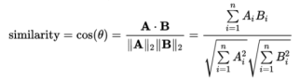
Algorithms/Techniques
Distance Based Model
Content filtering
Collaborative Filtering
SVD
Random Forest
Matrix Factorization Matrix
Probabilistic Matrix Factorization

Slide 9

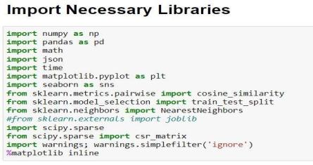
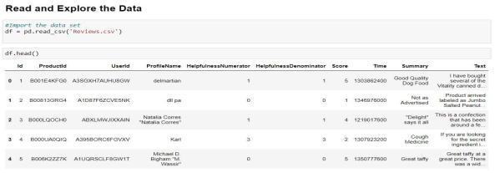
Implementation & Results

Slide 10
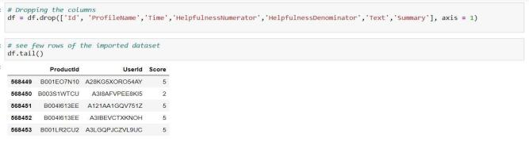
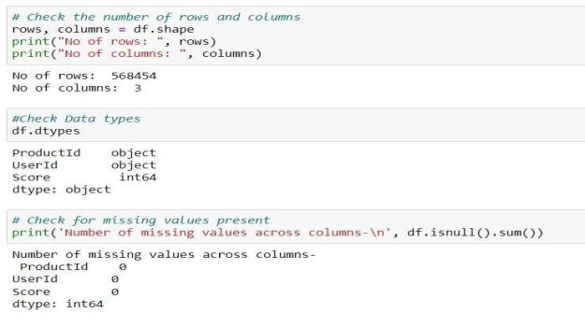

Slide 11
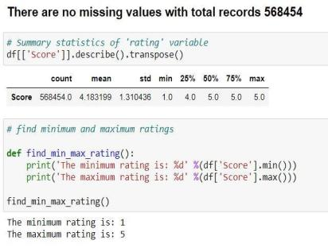
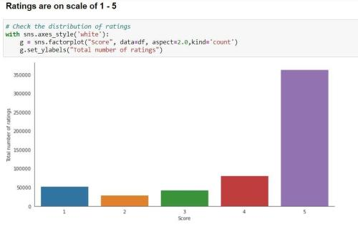

Slide 12
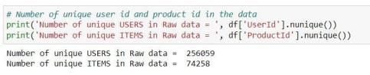
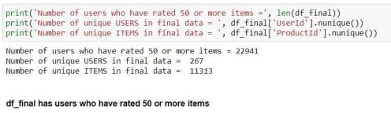
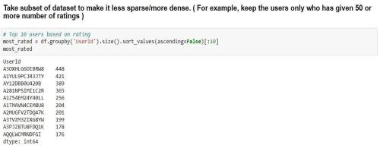
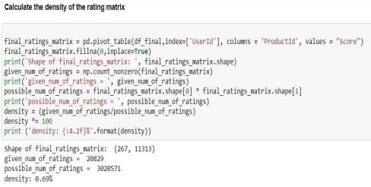
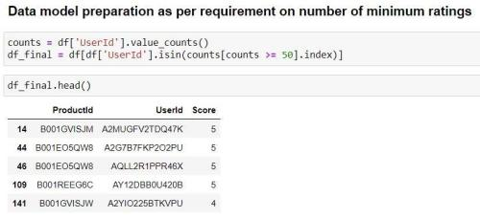

Slide 13
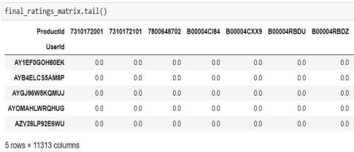
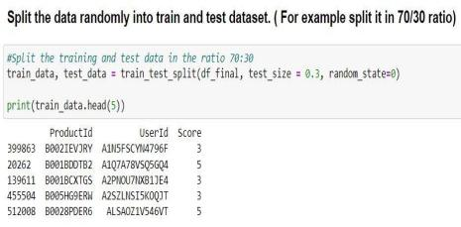
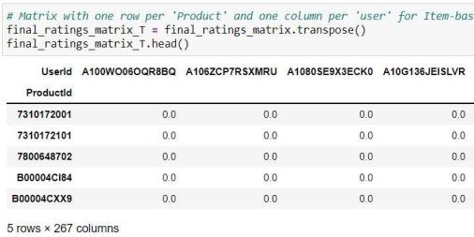
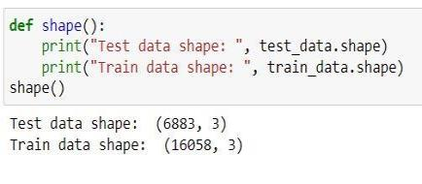

Slide 14
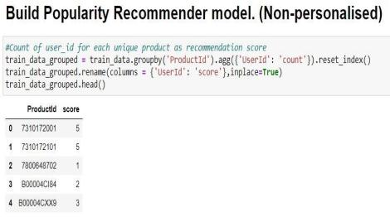
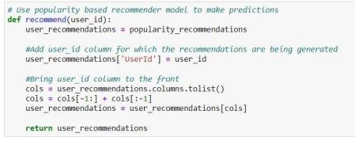
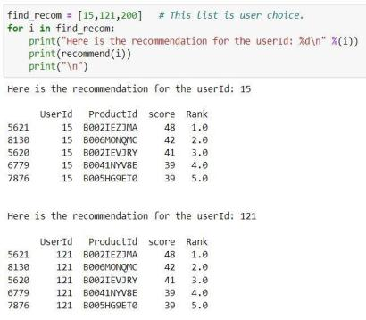
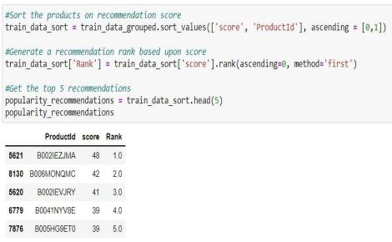

Slide 15
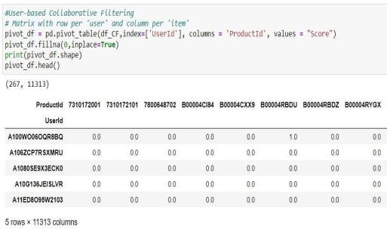
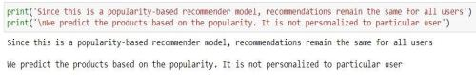
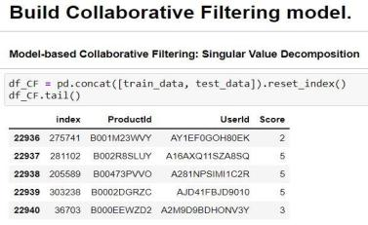
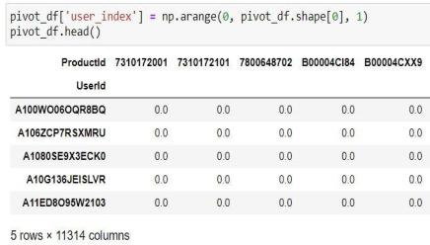

Slide 16
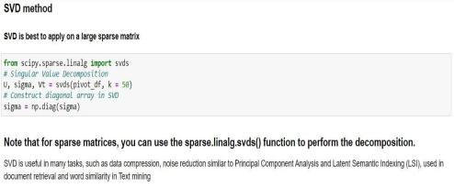
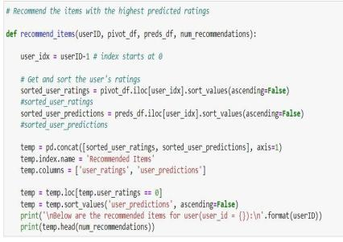
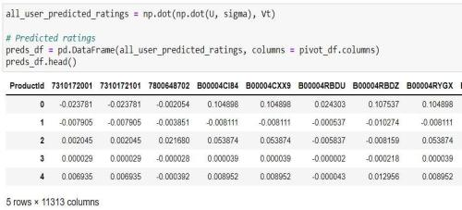
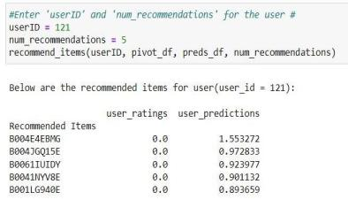

Slide 17
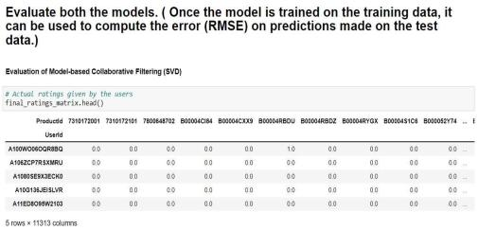
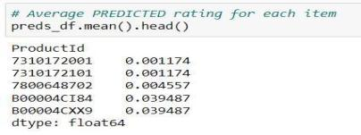
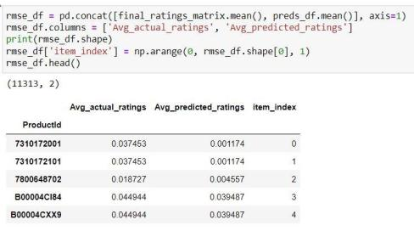
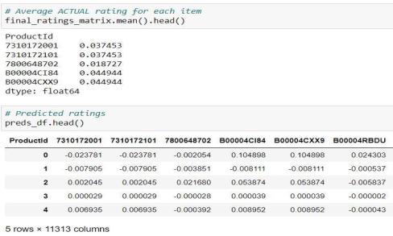
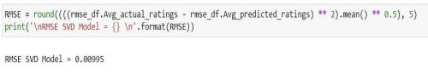

Slide 18
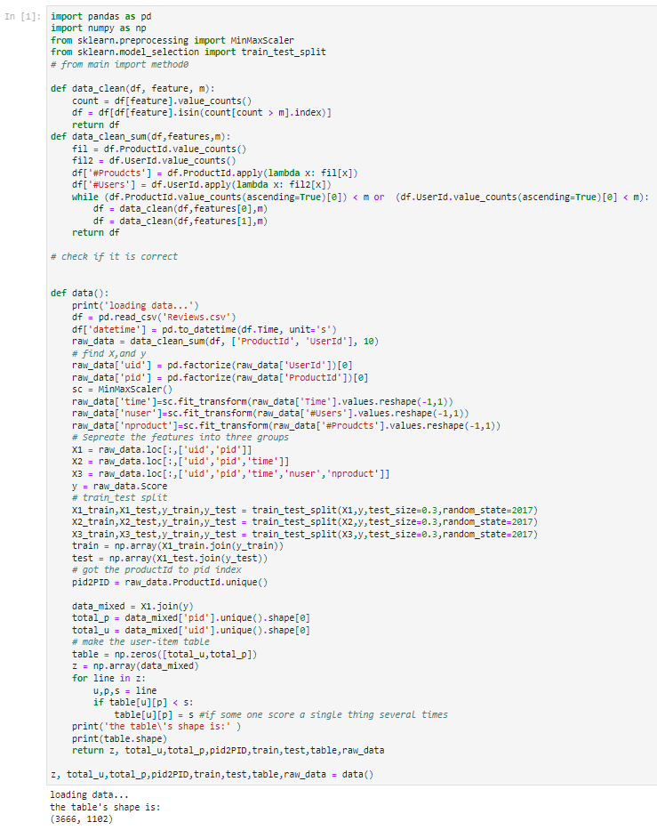
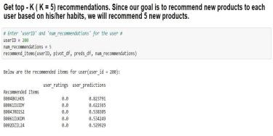

Slide 19
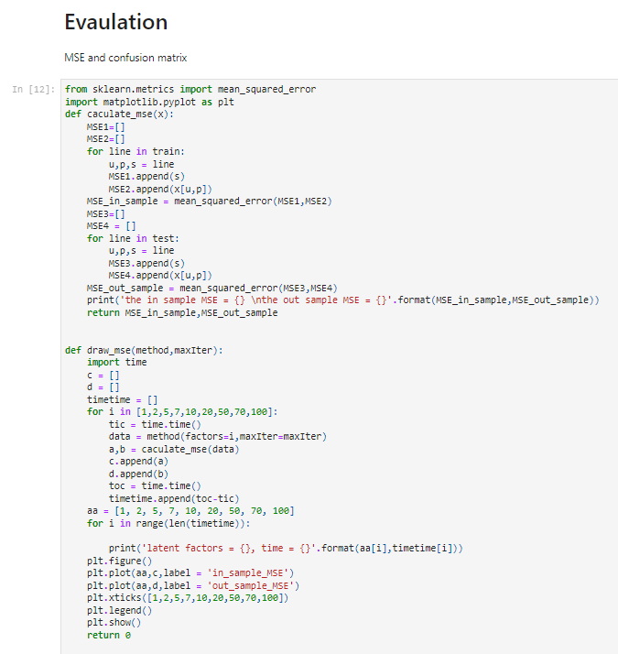
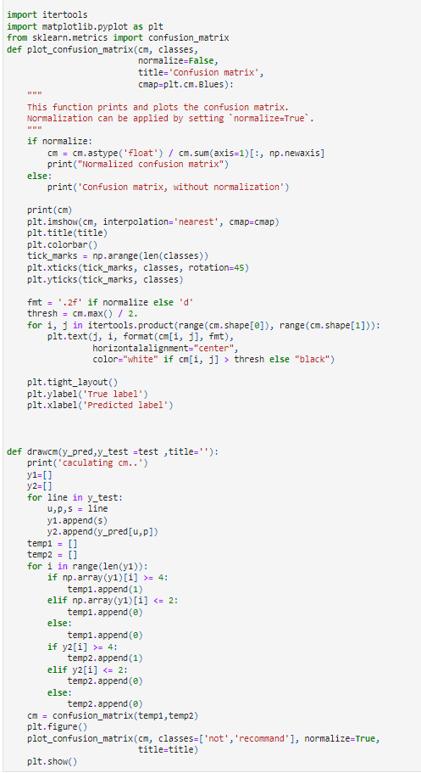

Slide 20
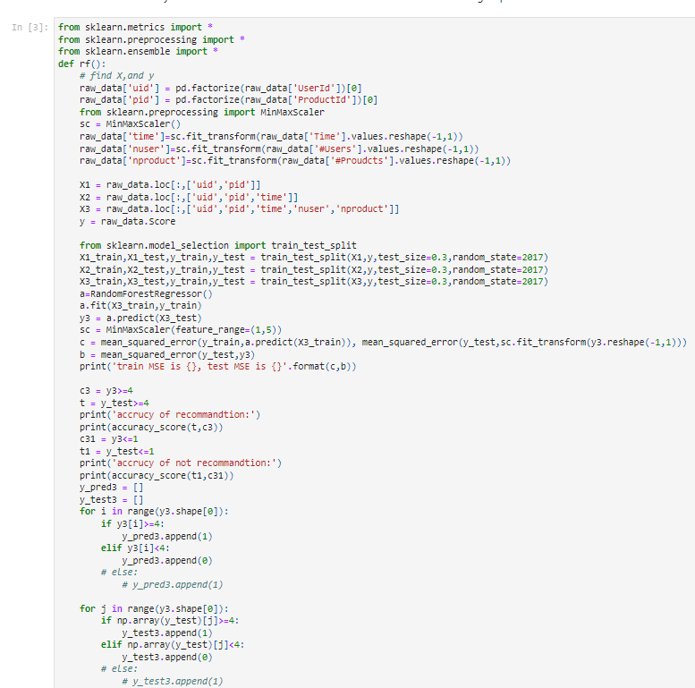
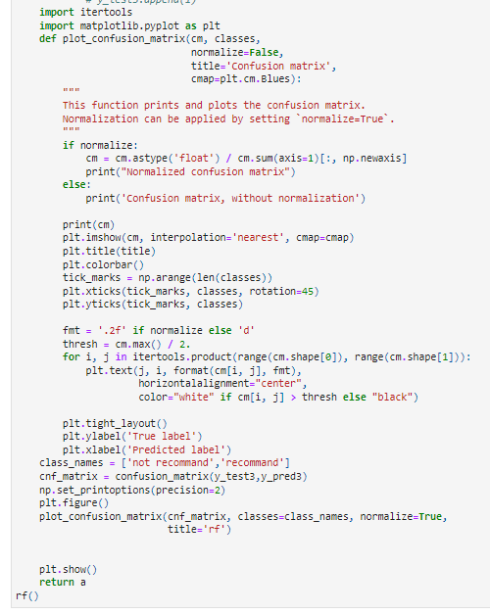

Slide 21
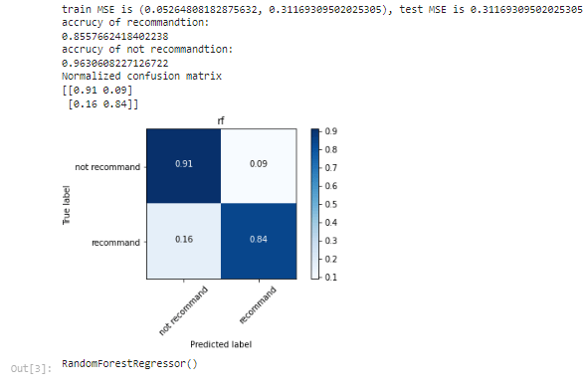
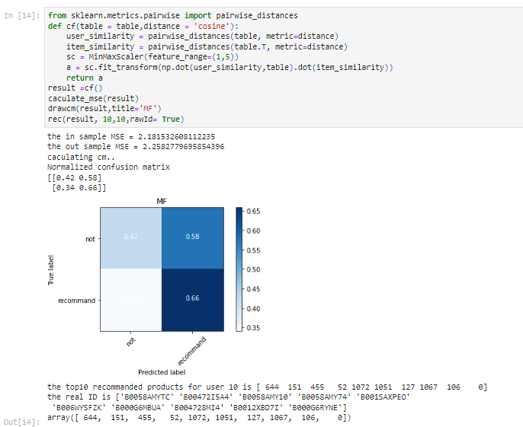
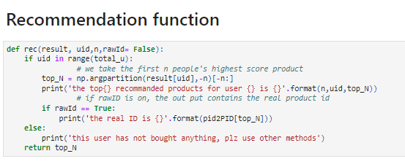
Distance Based Model
The advantage is that this method is quite interpretable. However, the drawbacks are also apparent: this algorithm is naive with a deficient performance. For a large data set, this algorithm needs m2+n2 times to calculate the similarity matrix.

Slide 22
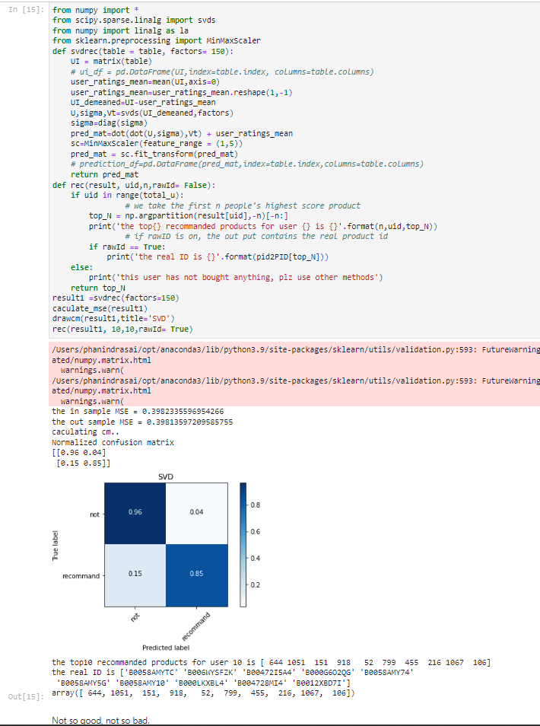
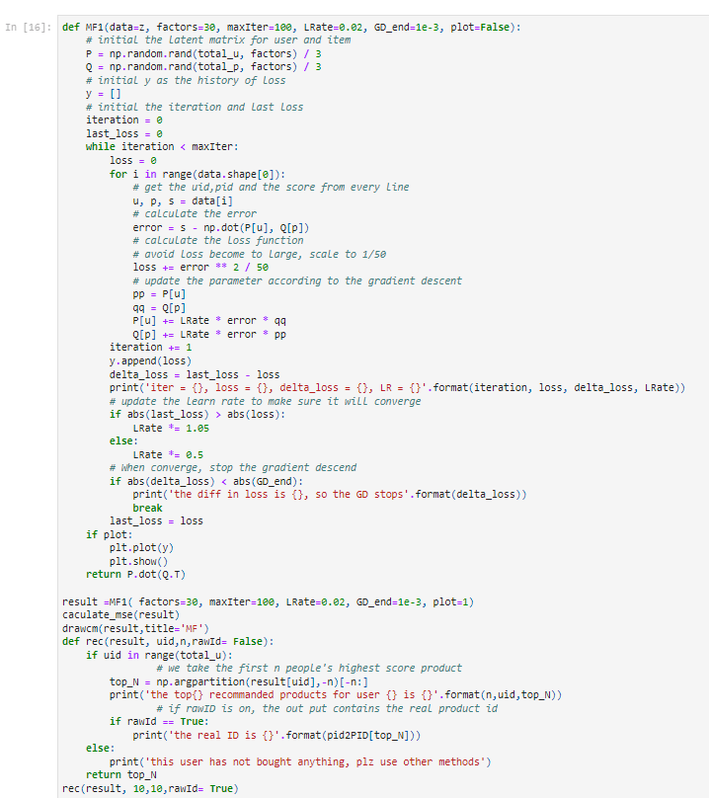
SVD
Matrix Factorisation

Slide 23
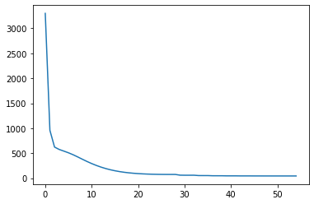
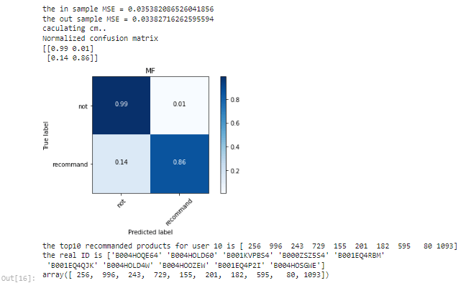
The MF gives a very good prediction: the train set MSE is 0.03542 and the test set MSE is 0.03385. While both MSEs are equally small, thus no overfitting problem occurs.
In addition, as image shows that the number of latent factors significantly affects the results.

Slide 24

As the number of latent factors increase, the MSE decreases. And MSE converges around n=20.

Slide 25


Probabilistic Matrix Factorization

Slide 26

Model Evolution graphs
Matrix Factorisation
The MF gives a very good prediction: the train set MSE is 0.03542 and the test set MSE is 0.03385. While both MSEs are equally small, thus no overfitting problem occurs.
In addition, as image shows that the number of latent factors significantly affects the results.

Slide 27

Probabilistic Matrix Factorization

Slide 28
Conclusion
Model-based Collaborative Filtering is a personalised recommender system, the recommendations are based on the past behavior of the user and it is not dependent on any additional information.
The Popularity-based recommender system is non-personalised and the recommendations are based on frequency counts, which may be not suitable to the user. You can see the difference above for the user id 121 & 200, The Popularity based model has recommended the same set of 5 products to both but Collaborative Filtering based model has recommended entirely different list based on the user past purchase history
We can find that the MF and PMF did a good job. And the recommendation they make are also very reasonable.
For example, the 10th user called 'G Little Value Seeker'. Based on what he bought, the chips, chocolate and tea we recommend him Starbuck coffee and some dark chocolate -- Mr. Value Seeker has not bought these, but I am sure he will like them!

Slide 29
GitHub Repository Link
https://github.com/phanindrasai27/Amazon-food-recommendation-system
REFERENCES
[1] Pang, Bo, and Lillian Lee.” Opinion mining and sentiment analysis.” Foundations and trends in information retrieval 2.1-2 (2008): 1-135.
[2] Lam, Savio LY, and Dik Lun Lee.” Feature reduction for neural network-based text categorization.” Database Systems for Advanced Applications, 1999. Proceedings., 6th International Conference on. IEEE, 1999.
[3] Sundermeyer, Martin, Ralf Schlter, and Hermann Ney.” LSTM Neural Networks for Language Modeling.” INTERSPEECH. 2012.
[4] Schafer, J. Ben, et al.” Collaborative filtering recommender systems.” The adaptive web. Springer Berlin Heidelberg, 2007. 291-324.
[5] Lops, Pasquale, Marco De Gemmis, and Giovanni Semeraro. ” Content-based recommender systems: State of the art and trends.” Recommender systems handbook. Springer US, 2011. 73-105.
[6] Koren, Yehuda, Robert Bell, and Chris Volinsky. ” Matrix factorization techniques for recommender systems.” Computer 8 (2009): 30-37.

Slide 30
[7] Van den Oord, Aaron, Sander Dieleman, and Benjamin Schrauwen. ” Deep contentbased music recommendation.” Advances in Neural Information Processing Systems. 2013.
[8] Pennington, J., Socher, R., & Manning, C. D. (2014, October). Glove: Global Vectors for Word Representation. In EMNLP (Vol. 14, pp. 1532-1543).
[9] Christopher Olah, Understanding LSTM Networks, retrieved from http://colah.github.io/posts/2015-08- Understanding-LSTMs/
[10] Hidasi, B., Karatzoglou, A., Baltrunas, L., & Tikk, D. (2015). Session-based Recommendations with Recurrent Neural Networks. arXiv preprint arXiv:1511.06939.
[11] Chellapilla, K., Puri, S., & Simard, P. (2006, October). High performance convolutional neural networks for document processing. In Tenth International Workshop on Frontiers in Handwriting Recognition. Suvisoft.
[12] Ioffe, S., & Szegedy, C. (2015). Batch normalization: Accelerating deep network training by reducing internal covariate shift. arXiv preprint arXiv:1502.03167. Chicago
[13] Bergstra, J., & Bengio, Y. (2012). Random search for hyper-parameter optimization. The Journal of Machine Learning Research, 13(1), 281-305. Chicago
[14] Srivastava, N., Hinton, G., Krizhevsky, A., Sutskever, I., & Salakhutdinov, R. (2014). Dropout: A simple way to prevent neural networks from overfitting. The Journal of Machine Learning Research, 15(1), 1929-1958.
[15] Derks, E. P. P. A., Pastor, M. S., & Buydens, L. M. C. (1995). Robustness analysis of radial base function and multi-layered feed-forward neural network models. Chemometrics and Intelligent Laboratory Systems, 28(1), 49-60.

Slide 31





Thank you

